Slide 1
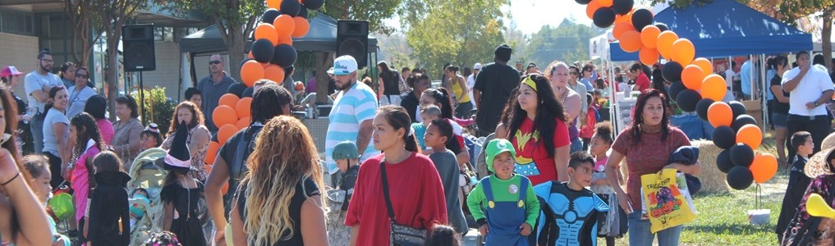
PLANNING FOR ACTION:
DRAFT ACTIONS LIST FOR REVIEW
CAC Meeting
April 2023

Slide 2
AGENDA
1. Welcome + Icebreaker
2. Action Planning Methodology
3. Draft Actions List
4. Announcements & Upcoming Activities

Slide 3
PROCESS RECAP: BUILDING AN ACTION PLAN
Conduct Outreach to Refine Actions and Recruit Partners for Action Teams
Identify
Issues
Brainstorm Actions + Prioritize
Take Action
How can we address this issue?
Community Advisors
What resources do I need?
How much would this cost?
Community Organizations MAN & City Partnership
Incorporate community priorities
Volunteer to flesh out action proposals and incorporate community feedback
Develop community partnerships
Funding and Support
Notes:
Note to MAN: There may be more action ideas that we need the Cas to support fleshing out that come from the community via the questionnaires, events, past planning processes, and more.

Slide 4
PROCESS RECAP: BUILDING AN ACTION PLAN
We are here
Conduct Outreach to Refine Actions and Recruit Partners for Action Teams
Identify
Issues
Brainstorm Actions + Prioritize
Take Action
How can we address this issue?
Community Advisors
What resources do I need?
How much would this cost?
Community Organizations MAN & City Partnership
Incorporate community priorities
Volunteer to flesh out action proposals and incorporate community feedback
Develop community partnerships
Funding and Support
Notes:
Note to MAN: There may be more action ideas that we need the Cas to support fleshing out that come from the community via the questionnaires, events, past planning processes, and more.

Slide 5
How will we prioritize?
What makes sense to do first?
What should we focus on?
Urgent community needs as understood from studies and recent and past community comments including…
Actions that build momentum and set foundations for community action in the future, considering…
Community workshop Survey Boulevard conversations Past plans and strategies Existing conditions analysis Neighborhood history review
Quick wins Existing momentum and partners Potential to build important partnerships and capacity Concentrated impact along the boulevard Advancing all priority topic areas

Slide 6
What will go into an action proposal?
ACCOUNTABILITY:
Who should be guiding the next steps and near-term goals
ACTION:
Concrete task that meets our goals/objectives
Establish a trash pickup group
Who should lead this effort? Who are potential partners? What should happen by 2024? What resources are needed?
Why is this action important?
What needs to happen?
MOVES:
Steps that steer the Action Plan toward successful change
1. 2. 3.

Slide 7
First Actions | Rationale | Existing Momentum + Partners | Later Actions
Develop a housing agenda for the boulevard Catalog and promote existing resources and programs for renters and homeowners Create a resource guide that shares information about what the City and providers are doing to support local unhoused people, and advocate for better feedback loops Provide input to educational offerings and services from partners | Taking action in this way will bring together residents and partners to identify specific housing priorities for the area, and explore options such as a land trust or other displacement measures, and to learn about existing services and programs. ed. A housing agenda is a quick win. | City initiatives include: Home repair program through Code Enforcement partnership with SMUD/Habitat/CRP Rental assistance and home repair through SHRA City submitted EPA grant for further resources for home repair Golden One initiatives include: Temporary bank location Homeownership Classes and Resources Chase Bank initiatives include: Business banking education | Create new funds and programs to provide property tax support and home improvement support for existing homeowners to help community members stay in their homes Facilitate educational programs that connect long-term residents who may need extra income with residents looking for housing (i.e. through ADUs or roommate matching program)
LIVE
Create and preserve affordable housing and home ownership opportunities for residents.

Slide 8
First Actions | Rationale | Existing Momentum + Partners | Later Actions
Business ambassador work with City staff to help businesses navigate existing programs and processes (e.g. permitting) Develop community-specific job board Expand workforce training services and target them to the needs of local and growing businesses | Taking action in this way will bring together residents and partners to identify and address barriers to existing programs. Having completed this, the community will be prepared to identify if further direct action is needed. A community job board is a quick win. | City initiatives include: Sac IEDC Business community liaison and TA CBCC MCSBC program for business TA 1913 pop ups Lost incubator concept (Alchemist) Chase Bank initiatives include: Considering creating one-stop business resource center | Create new funds and programs to invest in targeted infrastructure and property improvements for businesses Advocate for broadband and utility upgrades Create one-stop business resource Center Create area business attraction strategy Create business incubator Attract large anchor tenant
WORK
Foster and retain businesses that provide good job opportunities and career growth for workers in the community.

Slide 9
First Actions | Rationale | Existing Momentum + Partners | Later Actions
Promote, uplift, and gather feedback on façade improvements program Create community-led effort to identify, understand, and explore how to better activate vacant properties Create marketing and branding campaign for the corridor | Taking action in this way will bring together residents and partners to participate in the façade program will both improve the corridor and improve future programs by addressing barriers Creating a better understanding of what can be done about vacant properties will inform any future approaches Having completed this, the community will be prepared to identify if further direct action is needed. A branding campaign is a quick win | City initiatives include: Façade improvements program (City and District 2) Marketing/branding RFP Transformative Grants for tenant improvements, etc DPP planned activations on vacant lots/buildings in partnership with Unseen heroes/Capsity/Light and Water GSUL activations on Marysville and Grant vacant lot | Build coworking / shared space for business entrepreneurship (E.g. shared kitchen) Create popup program for vacant storefronts Identify funds for activation events Create artist fund for popups Attract grocery store, or develop co-op grocery Build community garden
SHOP
Create an inclusive retail corridor that meets the various shopping and entertainment needs of the community.

Slide 10
First Actions | Rationale | Existing Momentum + Partners | Later Actions
Create community-led effort to advocate for and directly maintain clean and safe streets (litter, graffiti, lighting, illegal dumping, animal control, etc.) Invest in lighting along the boulevard Create or advocate for youth programming and accessible, welcoming spaces for youth | Taking action in this way will bring together residents and partners to make improvements to the corridor will create visible improvements, and instill community pride Having completed this, the community will be prepared to identify if further direct action is needed. A clean and safe community team could be a quick win | City of Sacramento Public Work Transportation is working on a Safe Streets Grant and a Reinvesting Communities grant Alleyway improvement and activation is underway in the Dixieanne neighborhood Del Paso Partnership maintenance and security contractors City submitted EPA grant for assessment and visioning for Marysville/Grant intersection | Create safe street crossings initiative through signage, education, tactical and traffic calming interventions Advocate for resident-friendly community safety and monitoring / policing Identify a CBO to serve as an advocate, promoter, and liaison for ongoing planning processes Rethink gathering spots Create fund to pay for event fees Fundraise to reopen and maintain historic assets
EXPERIENCE
Foster inviting spaces and experiences where residents, workers, businesses and visitors can gather.

Slide 11
What’s happening along the corridor?

Slide 12
Action Plan
The final action plan document will include the full list of strategies that were considered
The document will:
Include descriptions of the actions
indicate which actions have been prioritized
Detail relevant info such as timeline, possible partners for outreach and discussion, and funding sources
Some of this information will be included in public-facing documents (e.g. action descriptions)
Some information may be excluded from public-facing documents until there has been approval (e.g. listed partners)
Source: Macon Action Plan

Slide 13
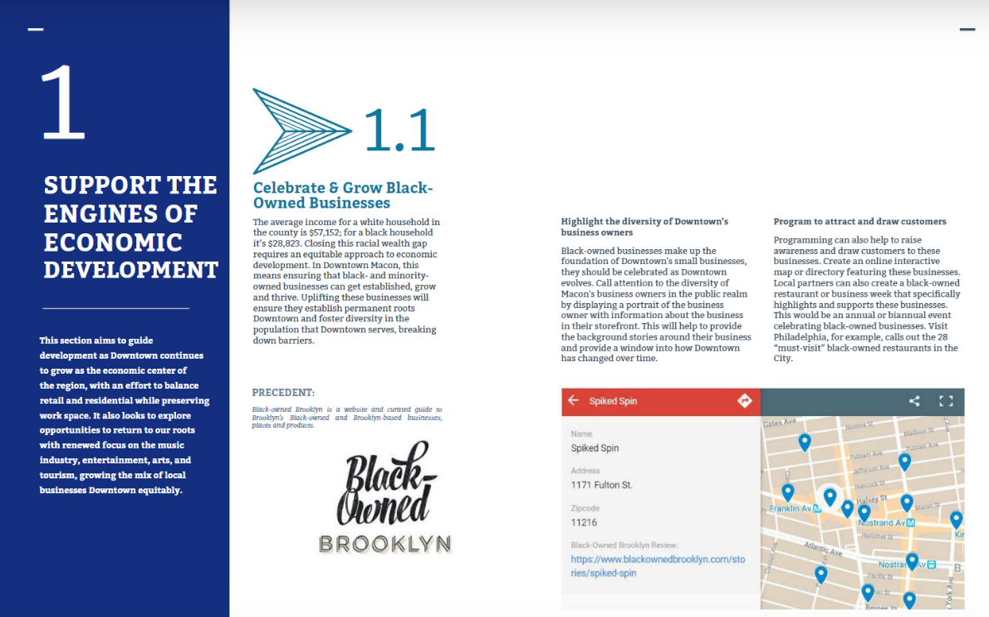
Action Profiles
In the action plan document, the project team will describe short-listed actions in greater detail
Information may include
Data that supports choosing this action or describes the change community members want to see
Specific sub-actions that would take place
Funding or partners who may play a role
Images or other graphics
Source: Macon Action Plan

