Slide 1
Curriculum for Guidance in Managing Academic
Biomedical Core Facilities
Alan Daugherty PhD DSc
Associate Vice President for
Core Facilities
Christopher Richards PhD
Associate Professor
Director, Light Microscopy Core
University of Kentucky
Jackie Willmot BSN MSN MBA
CEO and Co-founder
Eugene Krentsel PhD
Chief Scientific Officer and Vice President
XLerateHealth
Supported by: NIGMS STTR Award 3UT2GM148083-01S1

Slide 2
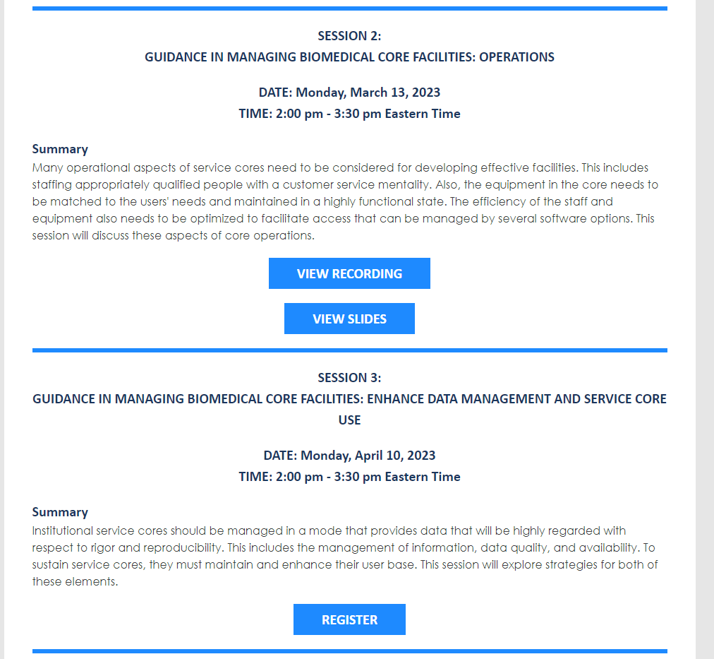
Curriculum for Guidance in Managing Academic
Biomedical Core Facilities
Curriculum
Session recordings
Slides
Available at: https://xleratornetwork.com/library/
Direct Communications
alan.daugherty@uky.edu
Zoom

Slide 3
Curriculum for Guidance in Managing Academic
Biomedical Core Facilities
Presentation is designed to promote discussion on the diverse topics of managing cores
Please ask questions at the end of each topic!
Raise hand icon (preferred)
Chat function
Discussion moderated by Dr. Chris Richards
Director, Light Microscopy Core, University of Kentucky

Slide 4
Curriculum for Guidance in Managing Academic
Biomedical Core Facilities - Overview
Session | Element # | Topic
Operations | 1 | Plan for staffing and equipment
 | 2 | Optimize staff and equipment usage and availability
Enhance data management and service core use | 3 | Manage information, data quality, and availability
 | 4 | Enhance the user base
Financial management | 5 | Develop rate structures
 | 6 | Fiscal management
Value assessment and contributions to the academic mission | 7 | Determine the value of service cores to the academic mission of the institute
 | 8 | Institutional oversight

Slide 5
Financial Management
Session | Element # | Topic
Financial management | 5 | Develop rate structures
 | 6 | Fiscal management

Slide 6
Element 5
Develop Rate Structures

Slide 7
5. Develop Rate Structures
Many biomedical service core facilities are supported by internal or extramural funding mechanisms when initiated. While this support may sustain a service core in the short term, implementation of a fiscal management plan at the initiation of the core will provide a path to sustainability
Transition to a Fee-for-service Facility
Pros and Cons of Rate Structure Development
Process
Compliance
Equipment Purchase
Ultimate Decision on Rate Setting
Time Frame for Cost Recovery
Financial management

Slide 8
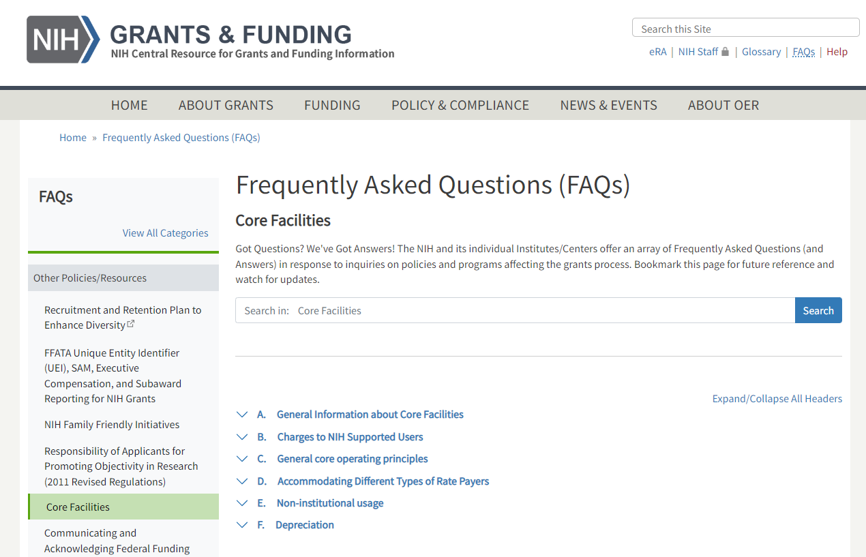
5. Develop Rate Structures
Financial management
NIH Information Source
https://grants.nih.gov/faqs#/core-facilities.htm?anchor=11205

Slide 9
5. Develop Rate Structures
Transition to a fee-for-service facility
Decisions
Expectation of being budget neutral or subsidized
Graded subsidy on launch or full charge on initiation
Real cost or influenced by comparators
Consideration of subsidy relative to benefit to research community
Setting a price point initially that will not be escalating dramatically in future years
Providing rates in advance to enable inclusion in grant applications
Discounted rates in low use times (nights and weekends)
Financial management

Slide 10
5. Develop Rate Structures
Pros and Cons of Rate Structure Development
Pros
Provides funding for the core
Efficient use of facility – reduction in excessive booking times and use
Inclusion of maintenance contracts
Financial management
Cons
Grumbling
Promoting options for accomplishing work outside the core

Slide 11
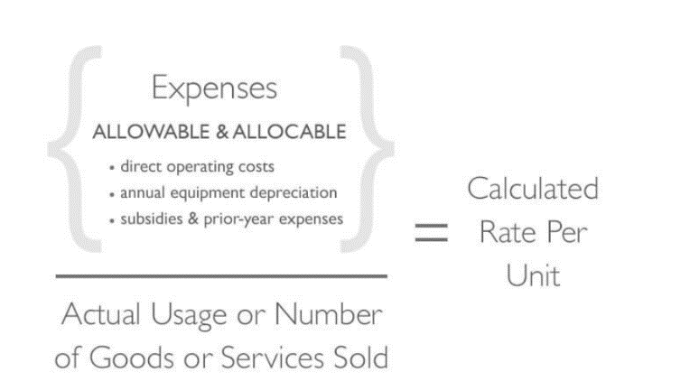
5. Develop Rate Structures
Process
The costs of providing service are allowable, allocable, consistently applied and reasonable
Financial management
Starting a New Core
John Hopkins web site
https://www.hopkinsmedicine.org/research/resources/synergy/core-in-a-box/

Slide 12
5. Develop Rate Structures
Process
The costs of providing service are allowable, allocable, consistently applied and reasonable
Core personnel provide data on projected expenses, revenue, and use per service
Rate structure spreadsheet developed
Approval from Scientific and Financial Oversight Committees
Approval from Central University Administration – e.g. Research Financial Services
Financial management

Slide 13
5. Develop Rate Structures
Process
The costs of providing service are allowable, allocable, consistently applied and reasonable
Required information
Define the services being provided
Personnel costs
Operating expenses
Consumables
Maintenance contracts
Depreciation
Estimated use of each service
Financial management

Slide 14
5. Develop Rate Structures
Process – Calculating Expenses
Financial management
https://www.uky.edu/ufs/service-center-recharge-operations

Slide 15
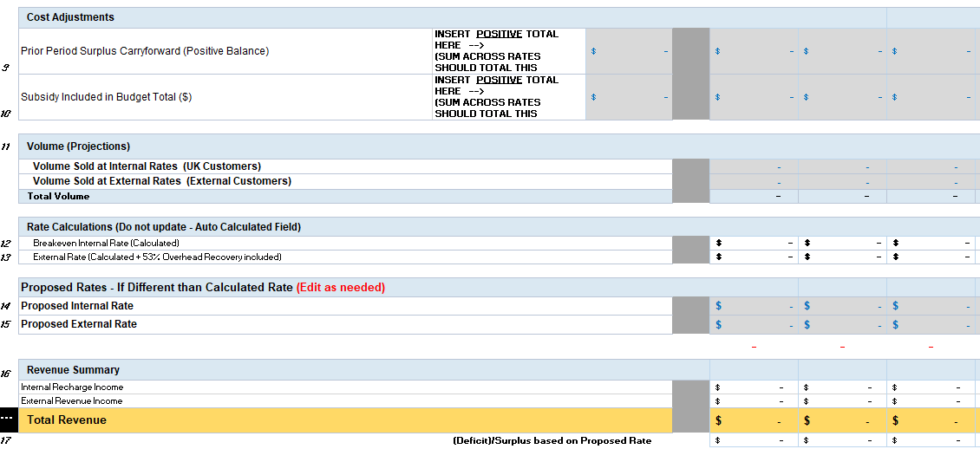
5. Develop Rate Structures
Process – Calculating Revenue
Financial management

Slide 16
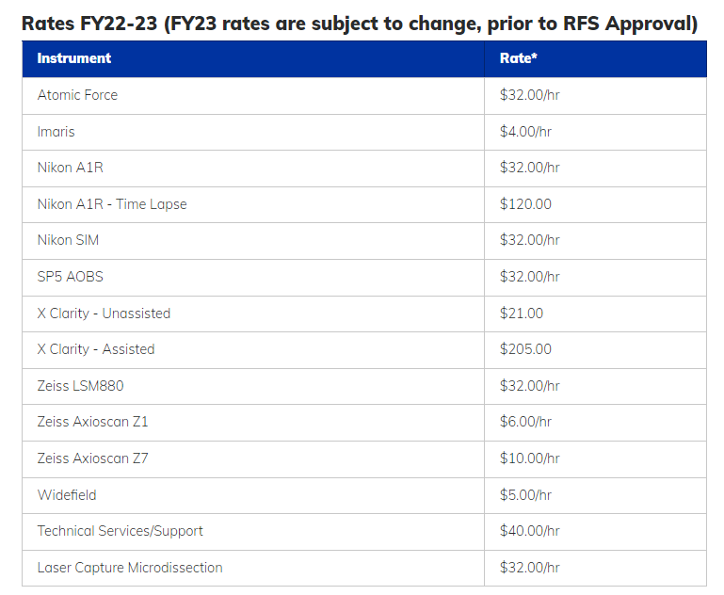
5. Develop Rate Structures
Process – Advertise
Financial management

Slide 17
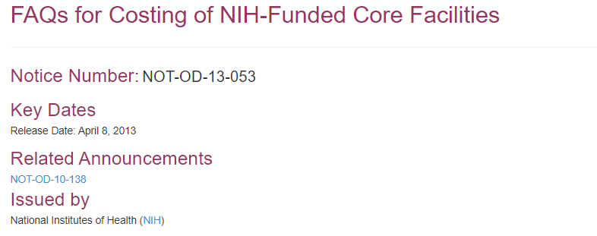
5. Develop Rate Structures
Compliance
Financial management
https://grants.nih.gov/grants/guide/notice-files/not-od-13-053.html
https://grants.nih.gov/grants/guide/notice-files/not-od-10-138.html

Slide 18
5. Develop Rate Structures
Compliance
Commons issues - 1
All internal users must be charged the same
Recipients of shared equipment grants or donors of equipment can not receive discounted rates
Priority can be provided to PI who provide equipment
Charges can be paid using partial or complete subsidy
Not allowable to charge above calculated rate
External fees – if NIH derived, should be treated as program income
Volume discounts – for example in start ups and centers
Financial management

Slide 19
5. Develop Rate Structures
Compliance
Commons issues - 2
Maximum allowable profit and debt is 10% of operating expenses
Equipment can not be purchased with profit from core (not a “current expense”)
Methods and details of rate structure development can be audited
Pre-payments are not allowed
An outside institute (another biomedical institute, educational institute, or commercial company can be charged a different rate)
External fees – if NIH derived, should be treated as program income
Financial management

Slide 20
5. Develop Rate Structures
Equipment Purchase – Acceptable Approaches
Recovery of existing equipment depreciation expense in user fees.
Institutional or other non-federal funding
Shared instrumentation grants
Program income which may accrue on NIH grants.
Lease or rental of equipment
Financial management

Slide 21
5. Develop Rate Structures
Ultimate Decision on Rate Setting
Based on Actual Calculated Rate
OR
A subsidized rate (for example; based on comparator analysis with other institutes)
Financial management

Slide 22
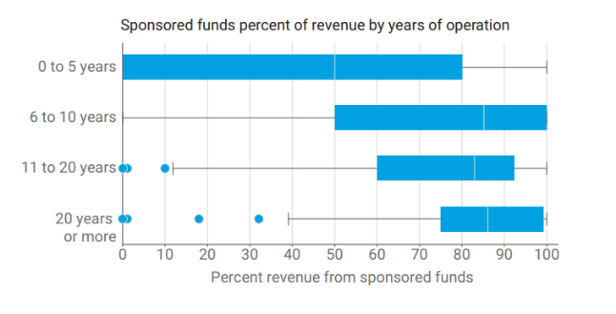
5. Develop Rate Structures
Time Frame for Cost Recovery
Cost recovery from sponsored funds increases after 5 years
Financial management
Strubczewski, “Shared Resource Facility Market Analysis,” Agilent, Dec 2, 2019

Slide 23
We would like your thoughts on the below topics:
Is anything that has been said inconsistent with your own institutional operating principles?
How do you determine yearly changes in rates?
Do you see any benefits of lower off hours rates?
Questions

Slide 24
Element 6
Fiscal Management

Slide 25
6. Fiscal Management
For cores to be sustained, develop a realistic fiscal management that is executed in a mode consistent with all applicable regulations.
Provide core personnel with continuous access to financial data
Meetings to discuss service use and finances
Monitor service use
Determine modes of optimizing core operations
Block booking restrictions
Flexibility to charge or time of use versus booked – depending on which is greater
Financial management

Slide 26
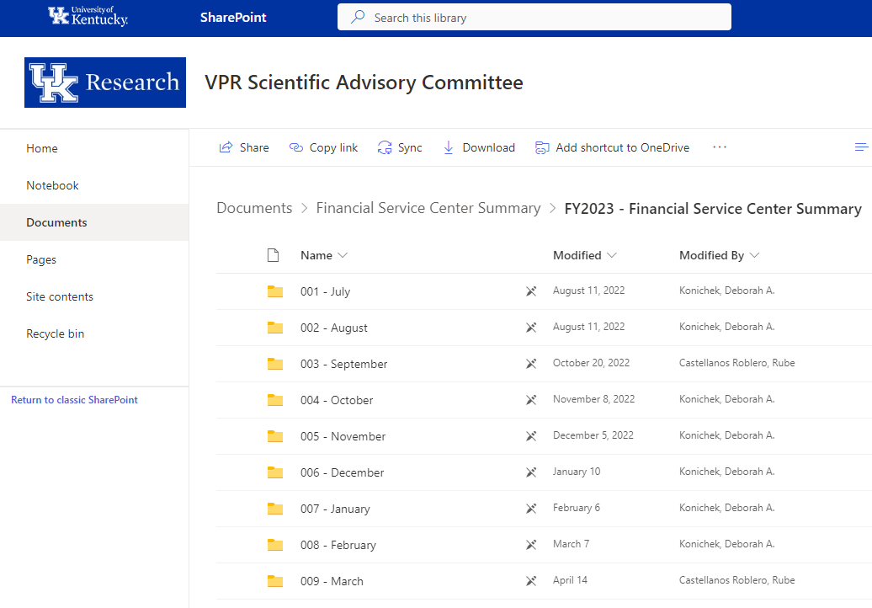
6. Fiscal Management
Providing Core Personnel with Continuous Access to Financial Data
Financial management

Slide 27
6. Fiscal Management
Providing Core Personnel with Continuous Access to Financial Data
Financial management

Slide 28
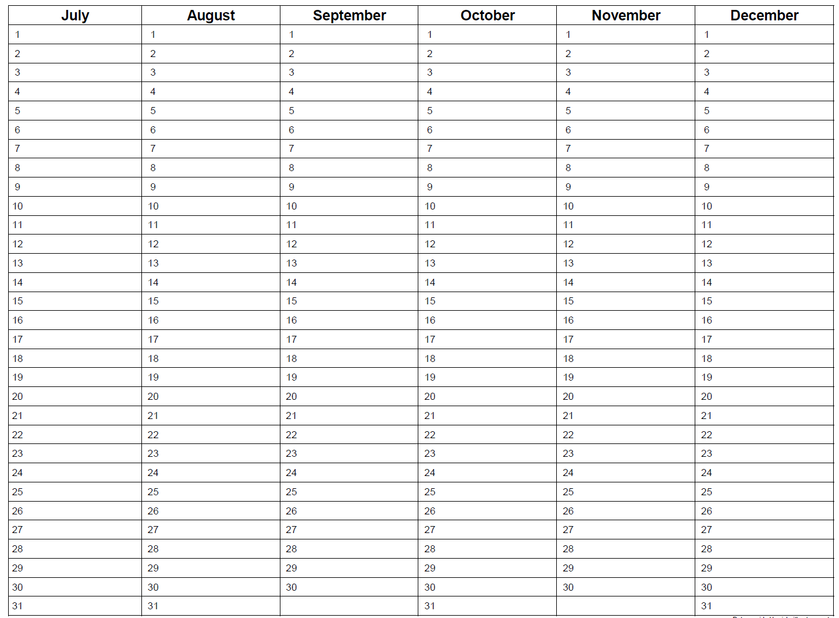
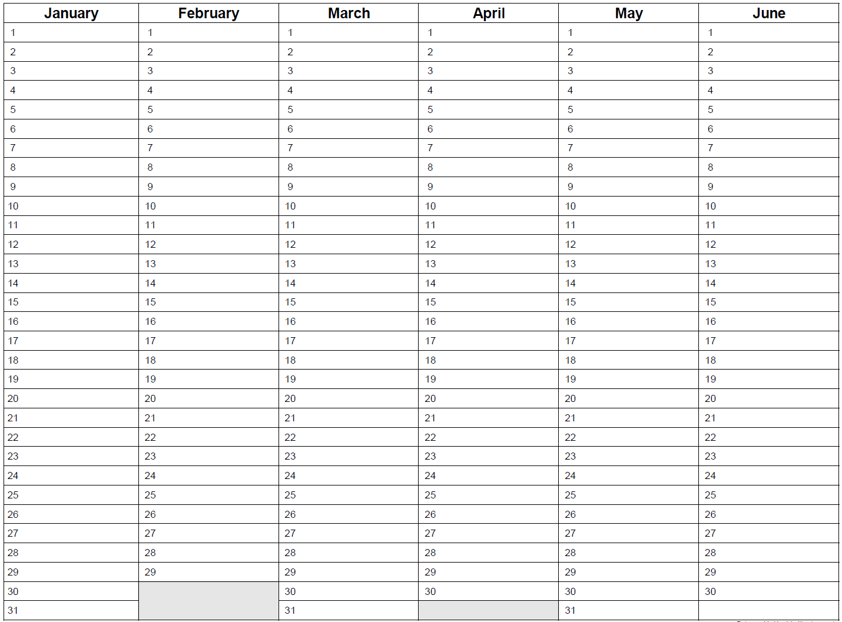
6. Fiscal Management
Regular Meetings to Discuss Service Use and Finances
Quarterly meetings
Convey information to oversight committees
Financial management
Core Personnel meeting
Core Personnel meeting
Core Personnel meeting
Core Personnel meeting
Oversight
Committee Dissemination
Oversight
Committee Dissemination
Oversight
Committee Dissemination
Oversight
Committee Dissemination

Slide 29
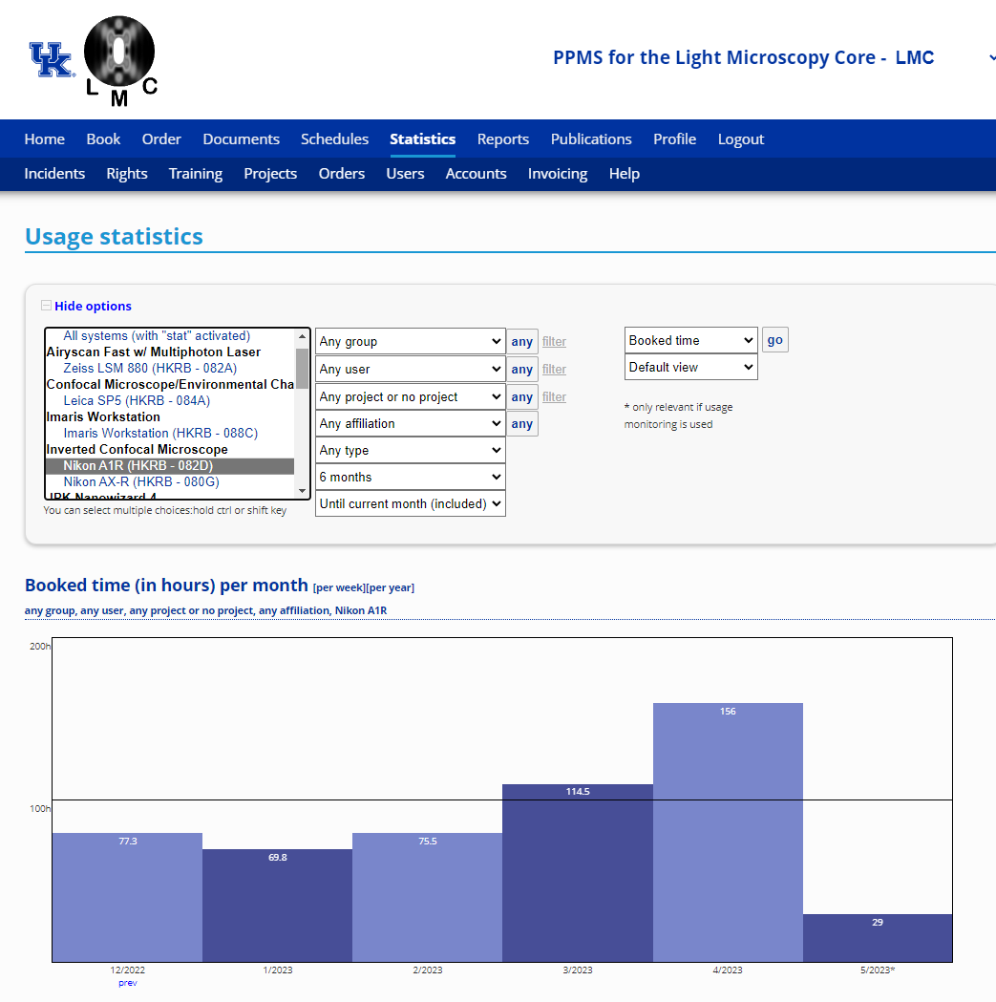
6. Fiscal Management
Monitor Service/Equipment Use
Financial management

Slide 30
6. Fiscal Management
Determine modes of optimizing core operations
Block booking restrictions
Limiting hours that can be booked – per session, per week, etc
Charge or time of use versus booked; whichever is greatest
Institutional responses to this as an acceptable practice
Financial management

Slide 31
We would like your thoughts on the below topics:
Modes that you have found to be effective for fiscal management
Questions

Slide 32
Value Assessment and Contributions to the Academic Mission
Session | Element # | Topic
Operations | 1 | Plan for staffing and equipment
 | 2 | Optimize staff and equipment usage and availability
Enhance data management and service core use | 3 | Manage information, data quality, and availability
 | 4 | Enhance the user base
Financial management | 5 | Develop rate structures
 | 6 | Fiscal management
Value assessment and contributions to the academic mission | 7 | Determine the value of service cores to the academic mission of the institute
 | 8 | Institutional oversight

Slide 33
Curriculum for Guidance in Managing Academic
Biomedical Core Facilities – Schedule for 2023
Session | Date | Time (EST)
Operations | March 13 | 2-3:30 pm
Data management and enhancing service core use | April 10 | 2-3:30 pm
Financial management | May 15 | 2-3:30 pm
Value assessment and contributions to the academic mission | June 12 | 2-3:30 pm

Slide 34
Feedback
Alan Daugherty
alan.daugherty@uky.edu
Session recording and slides will be available at:
https://xleratornetwork.com/library/

